Slide 1
Introduction: Convolutional Neural Networks for Visual Recognition
boris .ginzburg@intel.com

Slide 2
CS294-129: Designing, Visualizing and Understanding Deep Neural Networks
John Canny
Fall 2016
Lecture 6: Projects and Training Neural Networks I
Based on notes from Andrej Karpathy, Fei-Fei Li, Justin Johnson

Slide 3
Acknowledgments
This presentation is heavily based on:
http://cs.nyu.edu/~fergus/pmwiki/pmwiki.php
http://deeplearning.net/reading-list/tutorials/
http://deeplearning.net/tutorial/lenet.html
http://ufldl.stanford.edu/wiki/index.php/UFLDL_Tutorial
… and many other

Slide 4
Agenda
Overview
Introduction to Deep Learning
Classical Computer Vision vs. Deep learning
Introduction to Convolutional Networks
Basic CNN Architecture
Large Scale Image Classifications
Detection and Other Visual Apps
Beyond machine vision

Slide 5
Buzz…

Slide 6

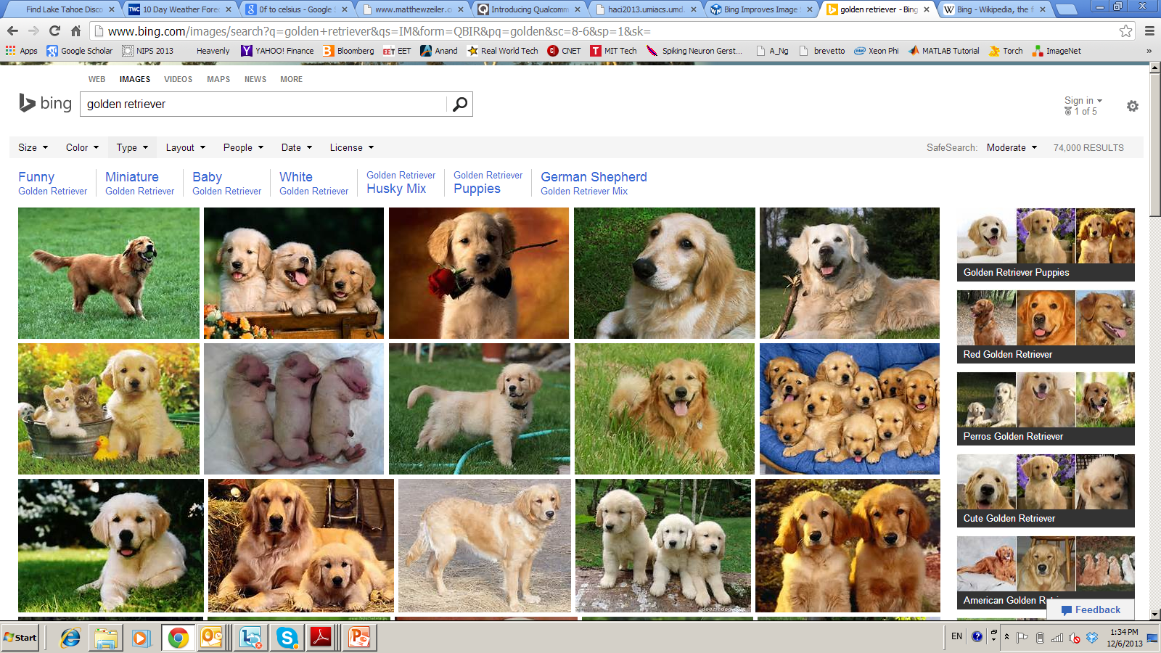


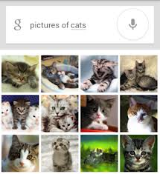

Deep Learning – from Research to Technology
Deep Learning - breakthrough in visual and speech recognition

Slide 7
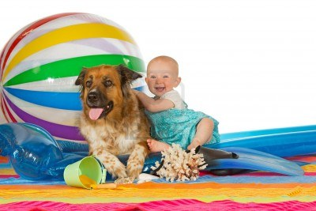
Classical Computer Vision Pipeline

Slide 8
Classical Computer Vision Pipeline.
CV experts
Select / develop features: SURF, HoG, SIFT, RIFT, …
Add on top of this Machine Learning for multi-class recognition and train classifier
Feature
Extraction:
SIFT, HoG...
Detection,
Classification
Recognition
Classical CV feature definition is domain-specific and time-consuming

Slide 9
Deep Learning –based Vision Pipeline.
Deep Learning:
Build features automatically based on training data
Combine feature extraction and classification
DL experts: define NN topology and train NN
Deep NN...
Deep NN...
Detection,
Classification
Recognition
Deep Learning promise:
train good feature automatically,
same method for different domain

Slide 10
Computer Vision +Deep Learning + Machine Learning
We want to combine Deep Learning + CV + ML
Combine pre-defined features with learned features;
Use best ML methods for multi-class recognition
CV+DL+ML experts needed to build the best-in-class
CV
features
HoG, SIFT
Deep
NN...
ML
AdaBoost
…
Combine best of Computer Vision
Deep Learning and Machine Learning

Slide 11
Deep Learning Basics
Deep Learning – is a set of machine learning algorithms based on multi-layer networks
CAT
DOG
OUTPUTS
HIDDEN
NODES
INPUTS

Slide 12

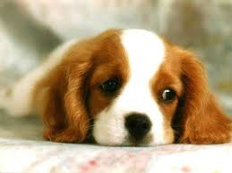
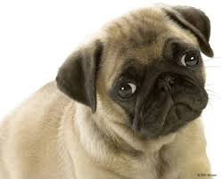
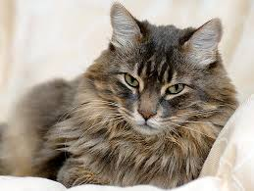
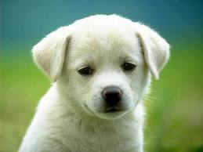

Deep Learning Basics
Deep Learning – is a set of machine learning algorithms based on multi-layer networks
CAT
DOG
Training

Slide 13
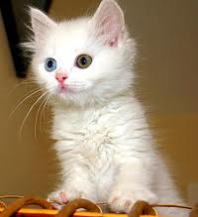
Deep Learning Basics
Deep Learning – is a set of machine learning algorithms based on multi-layer networks
CAT
DOG

Slide 14
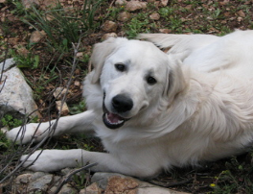
Deep Learning Basics
Deep Learning – is a set of machine learning algorithms based on multi-layer networks
CAT
DOG

Slide 15
Deep Learning Taxonomy
Supervised:
Convolutional NN ( LeCun)
Recurrent Neural nets (Schmidhuber )
Unsupervised
Deep Belief Nets / Stacked RBMs (Hinton)
Stacked denoising autoencoders (Bengio)
Sparse AutoEncoders ( LeCun, A. Ng, )

Slide 16
Convolutional Networks

Slide 17
Convolutional NN
Convolutional Neural Networks is extension of traditional Multi-layer Perceptron, based on 3 ideas:
Local receive fields
Shared weights
Spatial / temporal sub-sampling
See LeCun paper (1998) on text recognition:
http://yann.lecun.com/exdb/publis/pdf/lecun-01a.pdf

Slide 18
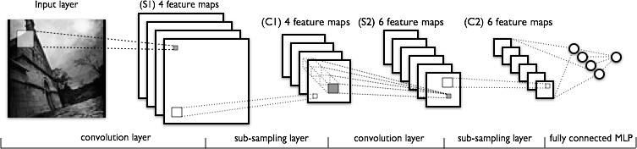
What is Convolutional NN ?
CNN - multi-layer NN architecture
Convolutional + Non-Linear Layer
Sub-sampling Layer
Convolutional +Non-L inear Layer
Fully connected layers
Supervised
Feature Extraction
Classi-
fication

Slide 19

What is Convolutional NN ?
2x2
Convolution + NL
Sub-sampling
Convolution + NL

Slide 20

CNN success story: ILSVRC 2012
Imagenet data base: 14 mln labeled images, 20K categories

Slide 21
ILSVRC: Classification

Slide 22
Imagenet Classifications 2012

Slide 23
ILSVRC 2012: top rankers
http://www.image-net.org/challenges/LSVRC/2012/results.html
N | Error-5 | Algorithm | Team | Authors
1 | 0.153 | Deep Conv. Neural Network | Univ. of Toronto | Krizhevsky et al
2 | 0.262 | Features + Fisher Vectors + Linear classifier | ISI | Gunji et al
3 | 0.270 | Features + FV + SVM | OXFORD_VGG | Simonyan et al
4 | 0.271 | SIFT + FV + PQ + SVM | XRCE/INRIA | Perronin et al
5 | 0.300 | Color desc. + SVM | Univ. of Amsterdam | van de Sande et al

Slide 24
Imagenet 2013: top rankers
http://www.image-net.org/challenges/LSVRC/2013/results.php
N | Error-5 | Algorithm | Team | Authors
1 | 0.117 | Deep Convolutional Neural Network | Clarifi | Zeiler
2 | 0.129 | Deep Convolutional Neural Networks | Nat.Univ Singapore | Min LIN
3 | 0.135 | Deep Convolutional Neural Networks | NYU | Zeiler Fergus
4 | 0.135 | Deep Convolutional Neural Networks |  | Andrew Howard
5 | 0.137 | Deep Convolutional Neural Networks | Overfeat NYU | Pierre Sermanet et al

Slide 25
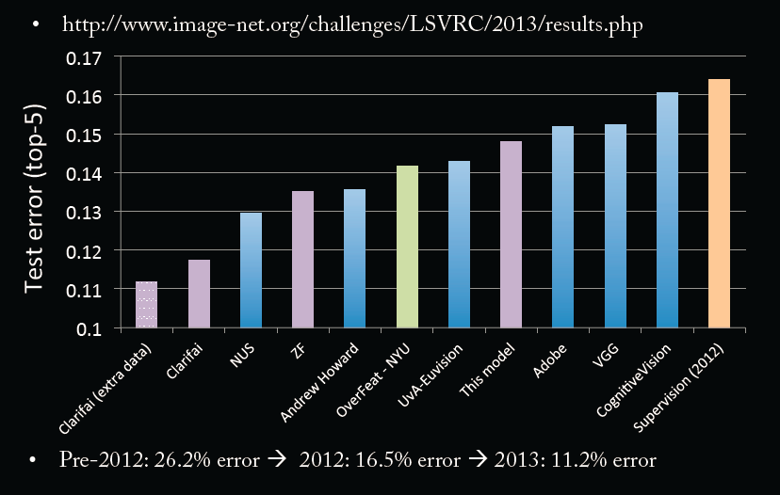
Imagenet Classifications 2013

Slide 26
Conv Net Topology
5 convolutional layers
3 fully connected layers + soft-max
650K neurons , 60 Mln weights

Slide 27
Conv Nets: beyond Visual Classification

Slide 28

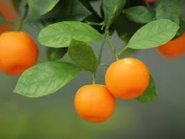
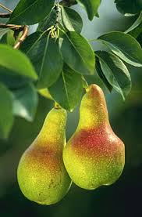
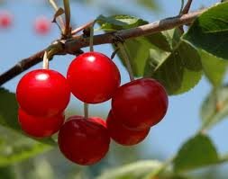
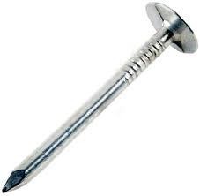
CNN applications
CNN is a big hammer
Plenty low hanging fruits
You need just a right nail!

Slide 29
Conv NN: Detection
Sermanet, CVPR 2014

Slide 30
Conv NN: Scene parsing
Farabet, PAMI 2013

Slide 31
CNN: indoor semantic labeling RGBD
Farabet, 2013

Slide 32
Conv NN: Action Detection
Taylor, ECCV 2010

Slide 33
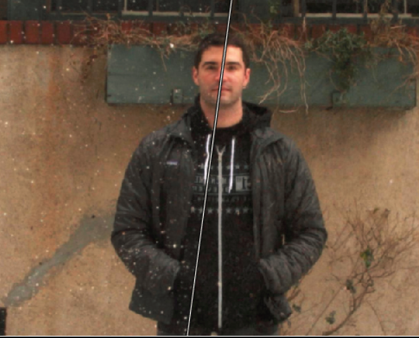
Conv NN: Image Processing
Eigen , ICCV 2010

Slide 34
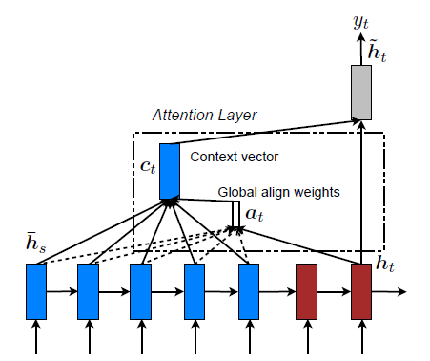
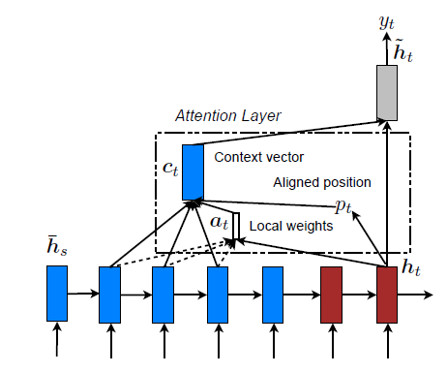
Machine Translation
Use sequence-to-sequence models + attention.
“Effective Approaches to Attention-based Neural Machine Translation” Minh-Thang Luong, Hieu Pham, Christopher D. Manning
Datasets: see paper

Slide 35
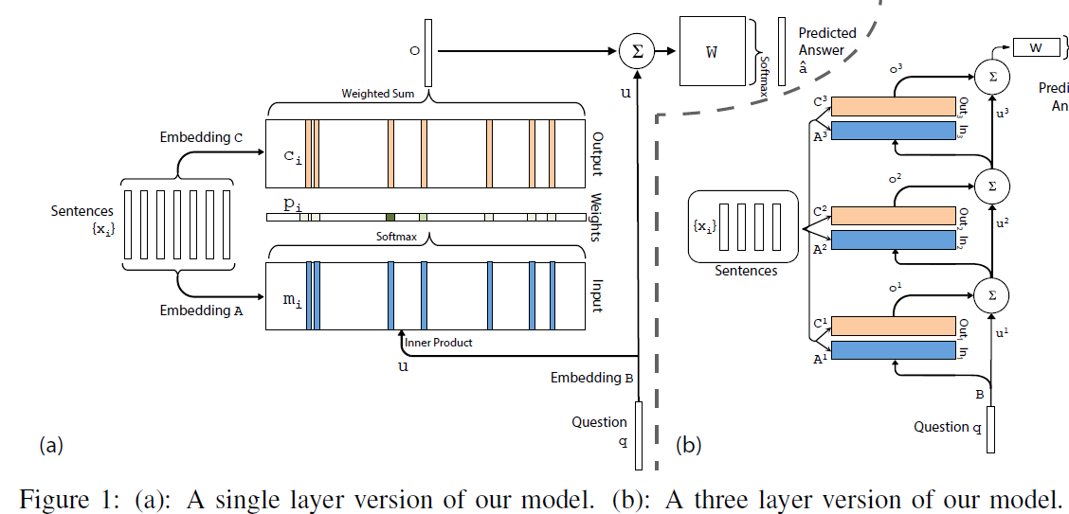
End-To-End Memory Networks
End to End Memory Networks (Tensorflow versions exist here and here)
Paper: S. Sukhbaatar, A. Szlam, J. Weston, and R. Fergus. End-to-end memory networks Dataset: https://research.facebook.com/research/babi/

Slide 36
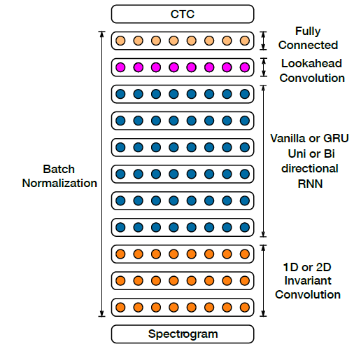
Deep Speech 2
Paper: Dario Amodei et al. “Deep Speech 2: End-to-End Speech Recognition in English and Mandarin”. Torch code: Here and here is an intro.
Datasets: TIMIT continuous speech data, WMT ‘15.

Slide 37
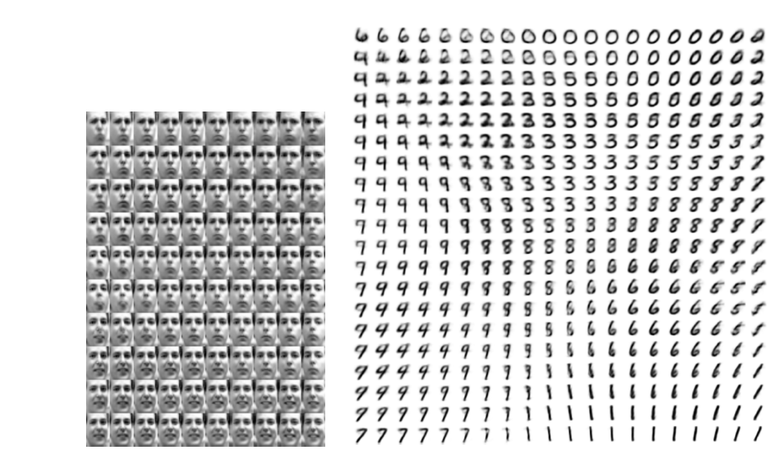
Variational AutoEncoders
Paper: D. Kingma and M. Welling. “Stochastic Gradient VB and the Variational Auto-Encoder” Dataset: MNIST, Could try CIFAR 10 or 100 or ImageNet

Slide 38
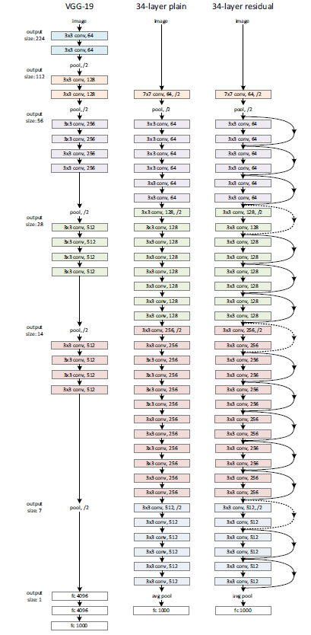
Residual Networks
Paper: Kaiming He et. al. “Deep Residual Learning for Image Recognition”
Torch code here
Dataset is CIFAR 10 or 100 or ImageNet

Slide 39
VGG: Oxford Group Network
Paper: Karen Simonyan and Andrew Zisserman. “Very Deep Convolutional Networks for Large-Scale Image Recognition”
Dataset is CIFAR 10 or 100 or ImageNet

Slide 40
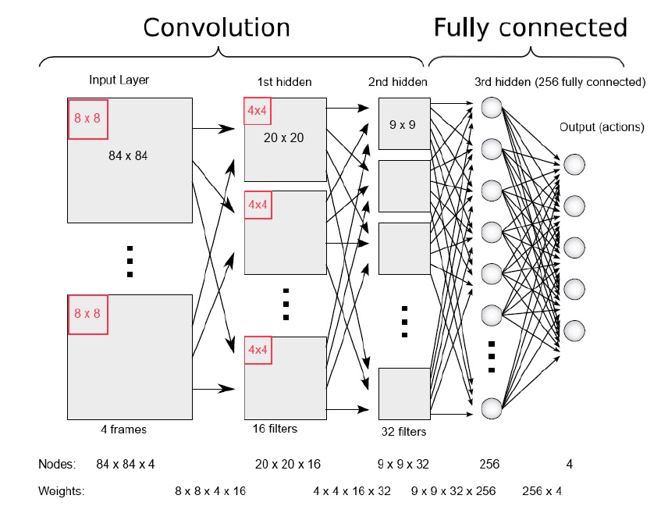
Deep Reinforcement Learning
Paper: Volodymyr Minh et. al. “Playing Atari with Deep Reinforcement Learning”. Dataset: http://www.arcadelearningenvironment.org/

Slide 41
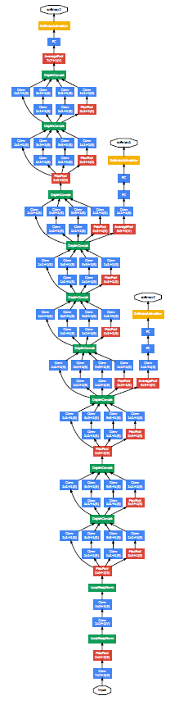
Inception/GooLeNet
Paper: Szegedy, C., Liu, W., Jia, Y., Sermanet, P., Reed, S., Anguelov, D., Erhan, D., Vanhoucke, V., and Rabinovich, A. Going deeper with convolutions
Dataset: CIFAR 10 or 100 or ImageNet

Slide 42
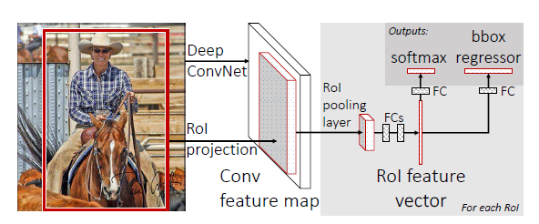
Fast R-CNN
Paper: Ross Girshick “Fast R-CNN”
Datasets: Pascal VOC07

Slide 43
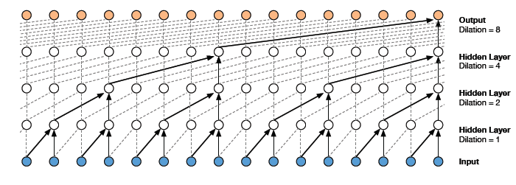
WaveNet
Paper: van den Oord et al: “WAVENET: A GENERATIVE MODEL FOR RAW AUDIO”
Dataset: VCTK (see paper)

Slide 44
Others
Object detection and localization
SSD: Single shot multibox detector https://arxiv.org/abs/1512.02325
in Caffe here: https://github.com/weiliu89/caffe/tree/ssd
R-FCN: Object detection via region based fully convolutional networks:
https://arxiv.org/abs/1605.06409
Caffe code here: https://github.com/daijifeng001/caffe-rfcn
Semantic Segmentation:
SegNet: A Deep Convolutional Encoder-Decoder Architecture for Robust Semantic Pixel-Wise Labelling http://arxiv.org/abs/1505.07293
Code in caffe here: https://github.com/alexgkendall/caffe-segnet
Fully Convolutional Networks for Semantic Segmentation
https://arxiv.org/abs/1411.4038
In Caffe branch: https://github.com/BVLC/caffe

Slide 45
Try it yourself
for example,
playground.tensorflow.org

